Slide 1
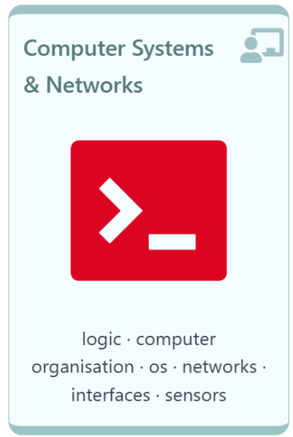
Welcome!!
Thursday 22ND May, 2025

Slide 2



Computer Systems & Networks
Caroline Cahill
caroline.cahill@setu.ie
Dr Frank Walsh
frank.w.walsh@setu.ie
Dr Mujahid Tabassum
mujahid.Tabassum@setu.ie

Slide 3
Computer Systems & Networks
10 Credit
Module delivery split between Mujahid, Frank & Caroline
Timetabled for TWO sessions per week

Slide 4
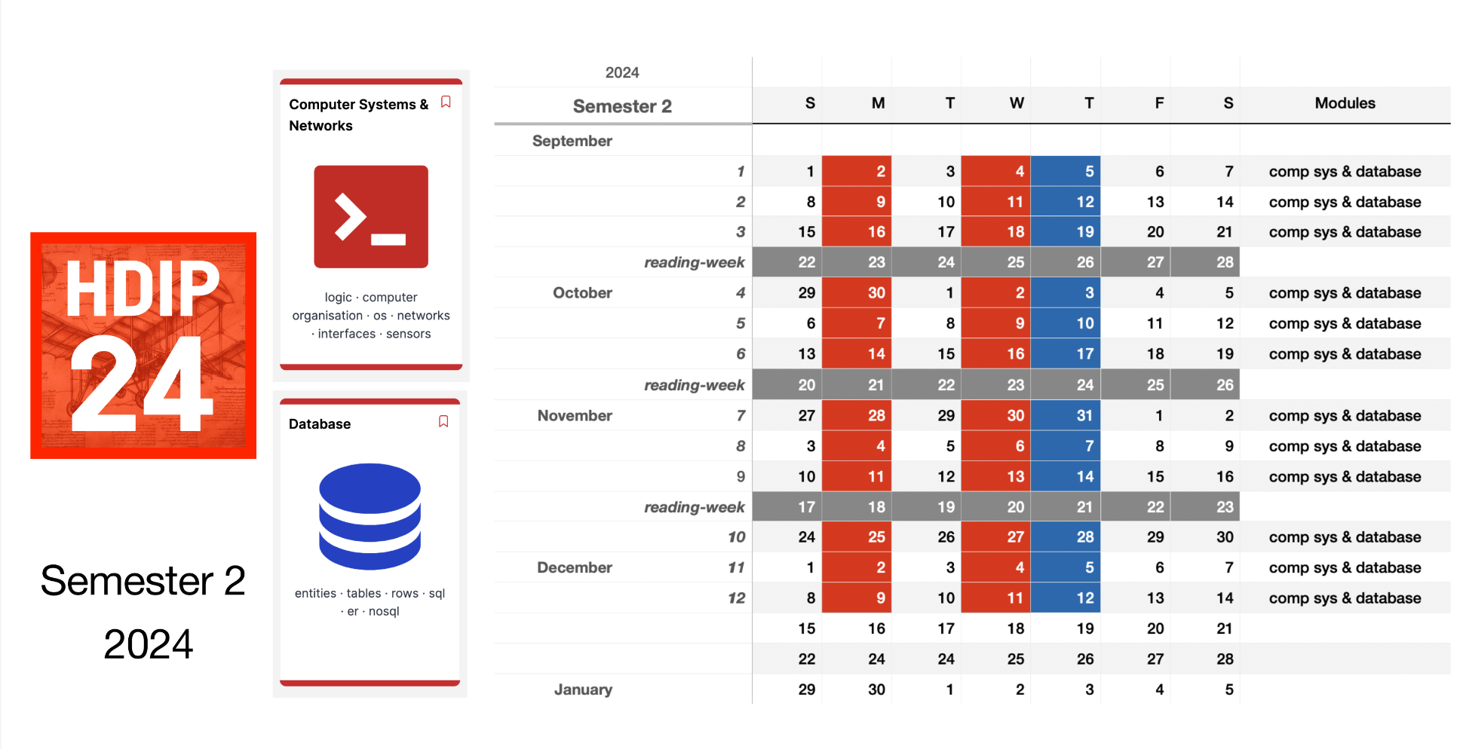

Semester 2
2025

Slide 5
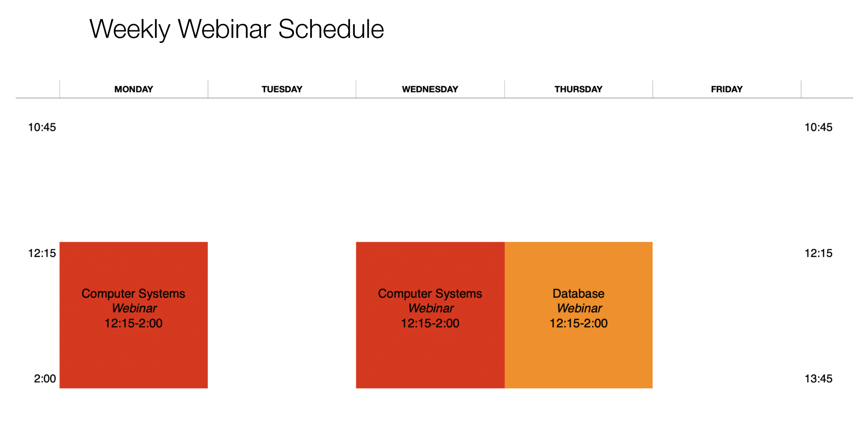
Notes:
Sometimes you might need to watch video, read article before lecture. - Same as programming.
Lectures are a mix of live and pre-recorded.
Labs every week (practical skills module) . Build something.

Slide 6
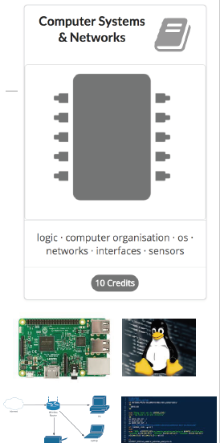
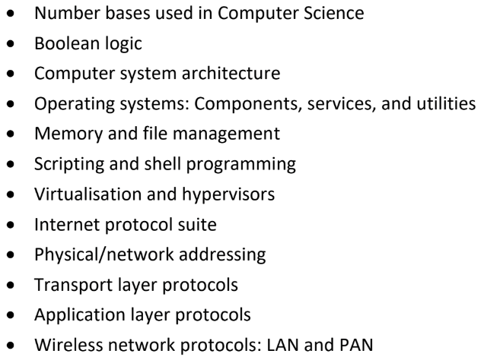
Module Overview(Tentative):
Notes:
Generally split into two parts: - Computer Systems (Caroline) - Networks (Frank) - Computer systems
Networking: protocols and function of computer networks – how the internet works.
Through the lense of the Internet of Things.

Slide 7



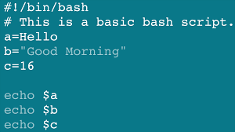

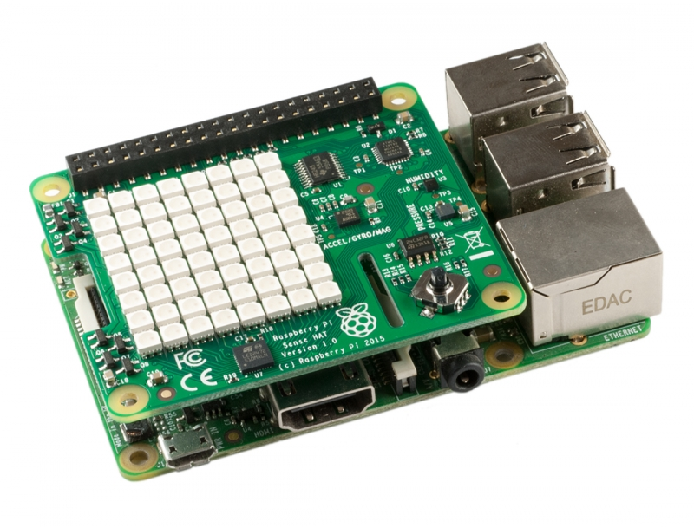

Development Tech (tentative)

Slide 8

Cisco NetAcad
You will complete up to and including Module 11

Slide 9

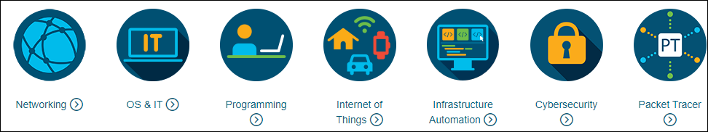
What is Cisco Network Academy?
Cisco Networking Academy is a global IT and cybersecurity education program that provides best-in-class courses, tools, and resources to help people from all backgrounds participate in the digital economy.

Slide 10
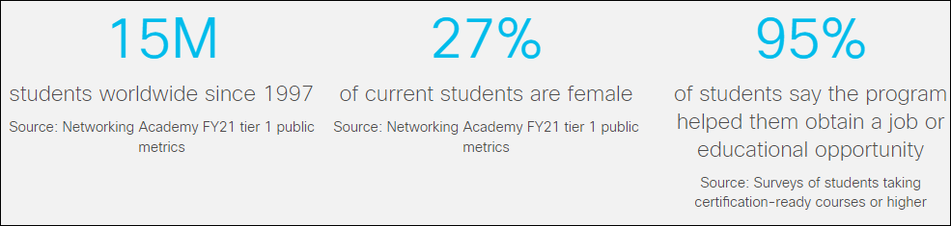
Netacad Students Around the Worlds
Notes:
In the last 20 years, Cisco educated more than 15 million students worldwide and produced good IT professionals.
According to Cisco students survey, 95% of students obtained a job opportunity after Cisco/Netacad education/certification.
As a Cisco academy, we are looking forward to provide 300 thousand unemployed and employees with high quality IT-training and upskilling them to catch up incoming jobs demands and needs.
If you look at LinkedIn, there are 8000+ IT (Networks, Administration and Security) jobs are available within Norway market.

Slide 11
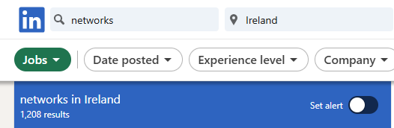

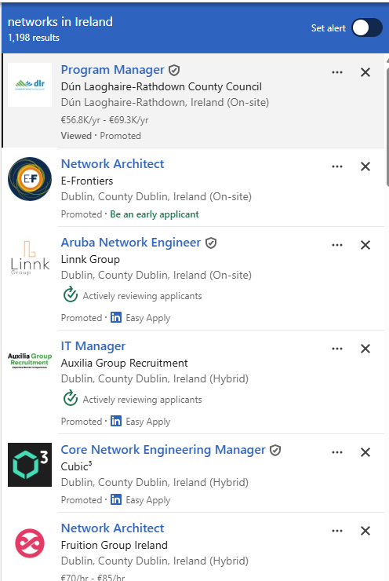
Networks and Cybersecurity Jobs in Ireland
Notes:
Cybersecurity have big future
You can explore the jobs in various domains

Slide 12


Jobs Market for Networking and Cyber Security Graduates
Notes:
By 2025, automation and a new division of labour between humans and machines will disrupt 85 million jobs. This Industry automation will destroy the job market.
97 million new jobs will be created by 2025 due to AI. So future job market is leading towards Network and Cybersecurity fields.
Cybersecurity Jobs Report that 3.5 million jobs will be open by 2025. Therefore, Networking and Security are good fields to find job and meet the future industry needs.

Slide 13
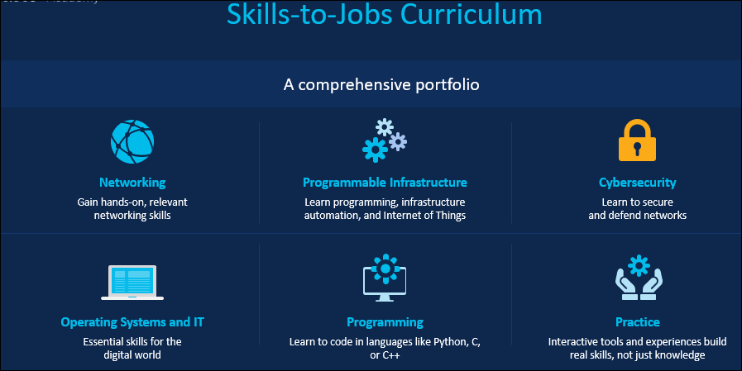
Career Path
Notes:
Cisco design skills-to-jobs curriculum to enhance learners experience and technological knowledge through online platform.
Netacad and Skill4All are offers high quality learning.
High quality learning
As a leader in technology, Cisco offers industry skills in areas like networking, programmable infrastructure, cybersecurity, operating systems and information technology, and programming.
Skills-to-jobs curriculum
Courses are developed with the end in mind: the skills required for success in a job role.
Courses are aligned to industry-recognized certifications. And learners can earn certificates and badges to verify skills to employers and share on LinkedIn.​
We keep curriculum relevant as industry needs evolve
Cisco curriculum portfolio is comprehensive that covers various technological fields.

Slide 14

Cisco Certifications

Slide 15
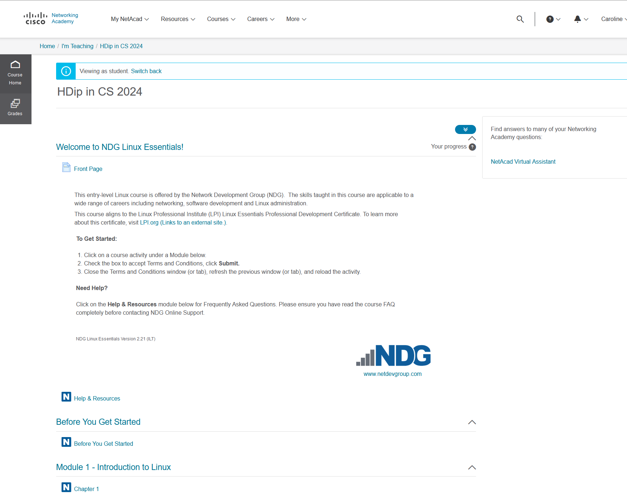
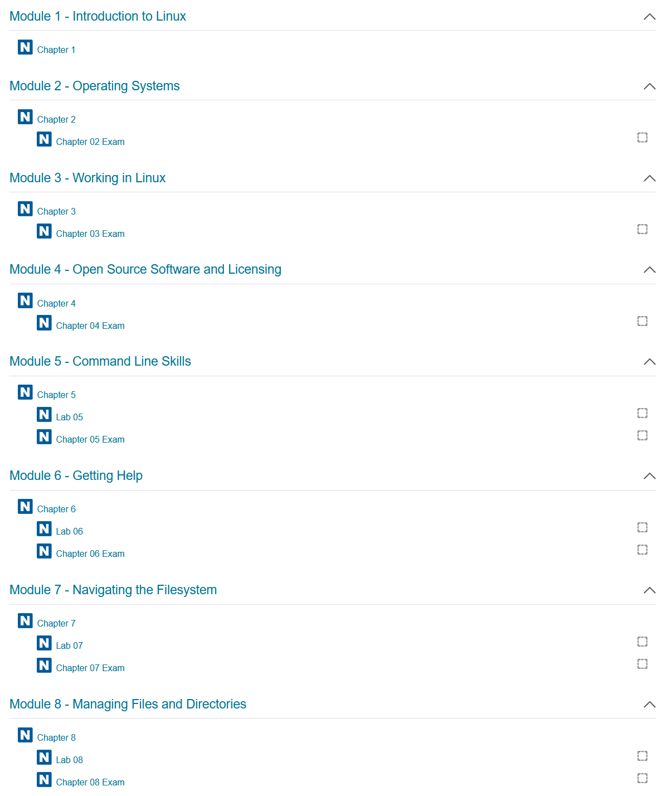

Slide 16
Using Linux
You can use WSL (windows subsystem for linux)
If using a Mac, the standard Mac terminal will be perfect
NOTE: If you use the mac terminal then you are working and making changes to your actual OS
You could use any emulator/any virtualiser software & then install Linux on top of this
(= keeps your Linux completely separate from your work system)
You could install VirtualBox & then install Lubuntu onto this
VirtualBox also won’t install on a M1/M2 chip as they removed support for it
You can use a UTM virtualiser (was created for macOS & only for Apple platforms)
You can install Lubuntu on a Raspberry Pi (the SD card will hold everything)
My screenshots in the notes will be taken off my own Lubuntu that I've installed in VirtualBox

Slide 17

Assignment Structure
100% Continuous Assessment
35% Assignment 1/ Labs
Computer Systems/Operating Systems
65% Assignment 2 / Networking Exercises
Networking/Devices

Slide 18
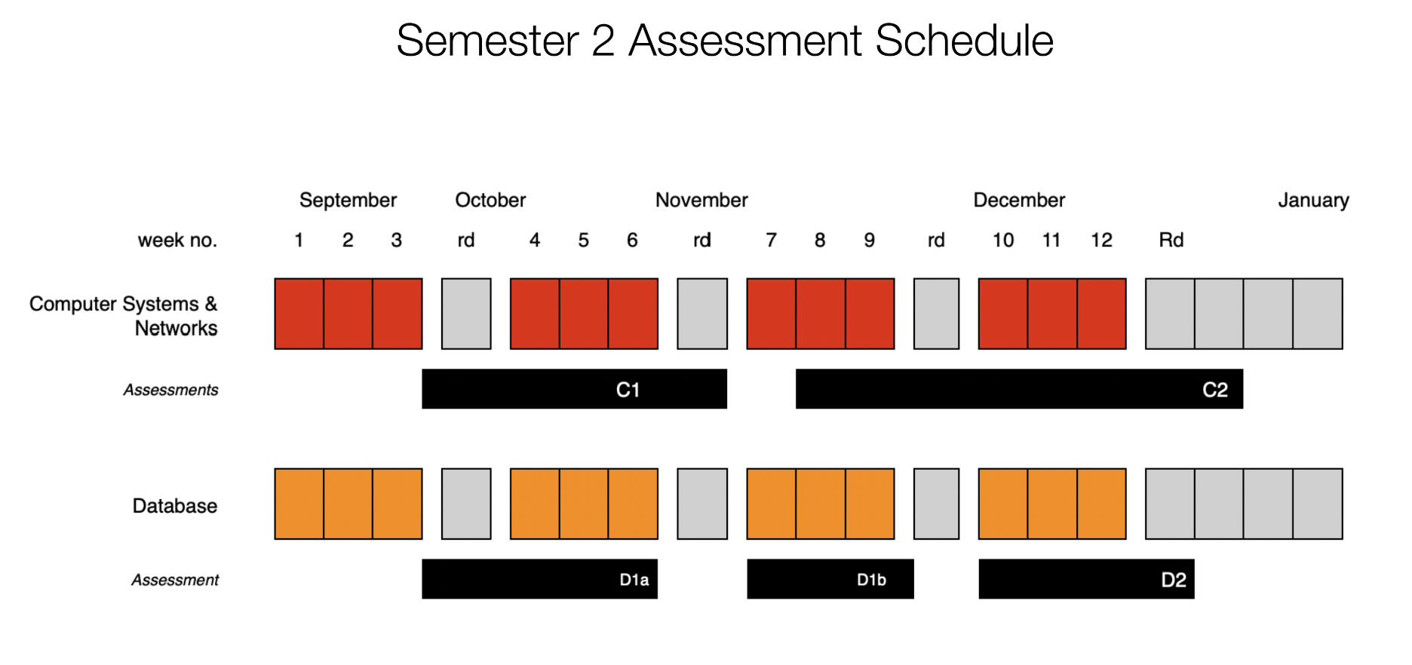

Slide 19
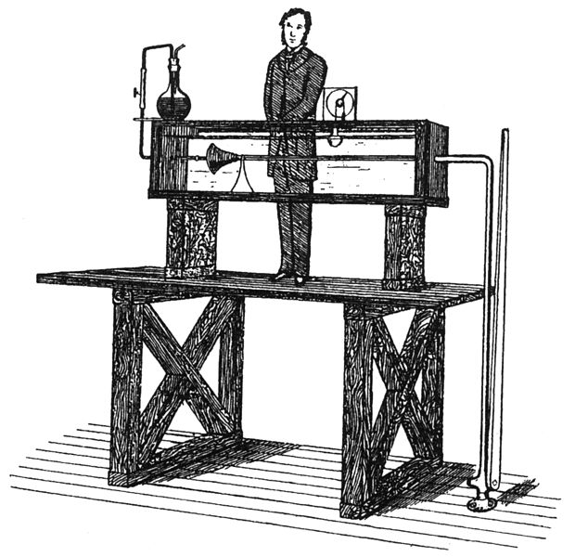
Ethos
Focus on practical skills
Good idea to stay current with module:
Some lectures will require reading/viewing of talks before.
Experiment/build something interesting:
You will have the opportunity to propose your own assignment!

Slide 20

Which will you use?

Slide 21
Linux Basics: Linus IS case sensitive
Caroline.txt is not the same as caroline.txt
File & Directory naming conventions (NO SPACES!!!)
CarolineCahill is a good filename i.e. capitalising the first letter of each word
The Linux prompt (Shell prompt) ends with a $ when logged in as a regular user

Slide 22
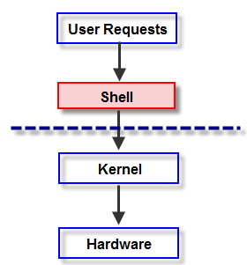
The Shell
In Linux, the shell is
a program that interprets commands
acts as an intermediary between the user and the inner workings of the OS

Slide 23
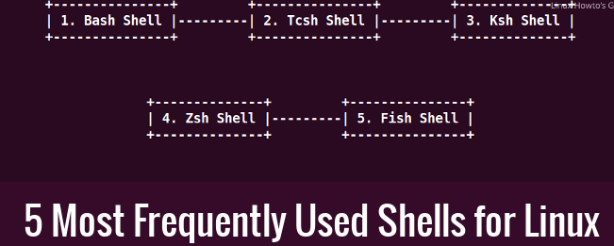
Which Shell is your system using?
Try out what happens if you type “echo $shell”
Find your system default by echoing the variable:
echo $SHELL
To close a shell, simply type:
exit

Slide 24
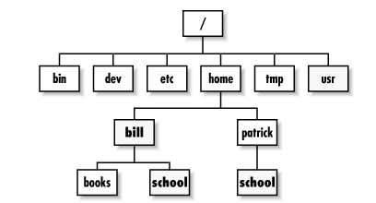
Directory Tree Structure
Type the ls command

Slide 25
Directory Tree Structure: what does yours look like?
Based on this hierarchy, can you
visualise how your filesystem looks?

Slide 26
Basic file & directory exercise
From home, create a new directory called OnSiteSETU
$mkdir OnSiteSETU
Inside this OnSiteSETU directory, create two subdirectories caroline and frank using the same mkdir command
Check they’re actually created.. [HOW??]

Slide 27
Solution:
home
OnSiteSETU
caroline
frank
tempAnyFile
Create another subdirectory tempAnyFile inside the frank directory

Slide 28

Type $cd ../ to return home
how can you check that you’re home?
From home, delete(remove) the empty caroline directory using the rm command
Do you get an error? Try adding the –r argument
$rm –r caroline
Check it’s removed … how?
3. From here, check that the tempAnyFile exists using
$ls frank

Slide 29
Command Manual
Every command has it’s own manual page
man <<command>>
Try it out:

Slide 30
Don’t forget Linux IS case sensitive!!!
$cd usr
IS NOT THE SAME AS
$cd Usr
Be mindful with creating names - make good use of $ls to view your directory names

